Slide 1
Predicting Bike Share Availability
Team KaZAM
Woochan Lee
Ziyan Xia
Yueni Wang
1

Slide 2



Agenda
Team KaZAM
Objectives and Assumptions ------- Page 3
Overview of the Dataset --------------- Page 4 - 6
Clustering of Stations --------------- Page 7
Final Model --------------- Page 8-10
Reshuffling Strategy --------------- Page 11-13
Actionable Recommendation ------- Page 14-15
Next Steps for Phase 2 Project ----- Page 16
Technical Appendix ---------------------- Page 19-24
Ziyan Xia
Woochan Lee
Yueni Wang
Notes:
Skim through

Slide 3

Objectives and Assumptions
Objectives:
Build a predictive model to improve bike availability and reshuffling strategies across Washington DC
Leverage existing bike share usage data through years to lower operational costs
Improve user experience and sustain existing market share for client’s core business
Assumptions:
Model does not take into account unpredictabilities during COVID pandemic
Reshuffling happens exactly halfway in time between a bike’s start trip and end trip disparities
Starting number of bikes in each station is total number of bikes that arrived at each station in previous month and did not leave
Weather data for a subset of stations is used to represent the overall weather for Washington DC area

Slide 4
Overview of the Raw Dataset
Raw data:
Dates: 2019 January 1st ~ 2019 December 31st
Historical and real time
Each observation is a trip history of Capital Bikeshare bikes - the data includes:
Duration
Start Date
End Date
Start Station
End Station
Bike Number
Member Type
Having electric bikes or not, etc.
Additional effort:
Retrieved weather data of Washington DC from NOAA website:
Precipitation
Temperature
Wind level
etc…
Utilized Capital Bikeshare’s API to retrieve
Longitude and latitude of each station
Total capacity of each station
Notes:
An important point to note here is that each observation contained information about the start trip and end trip combined, which we did not want when fitting the data
-not fatal flaw

Slide 5
Transformation of the Raw Dataset
3. Starting bike numbers
We assumed that the starting number of bikes in 2019 January were the total bikes that arrived in 2018 December
2. Adding reshuffle trips
We assumed that reshuffling occurred when bike last arrived at station A, but was recently picked up from station B
02
03
01
4. Defining availability
We defined availability to be the proportion of available bikes in a station at a certain time
1. Splitting raw data
Each observation of trips in the raw data was split into 2 separate trips:
Bike picked up
Bike dropped off
04
Notes:
The data needed to be transformed into a structure that could be fed into a predictive classification model
(we added … )

Slide 6
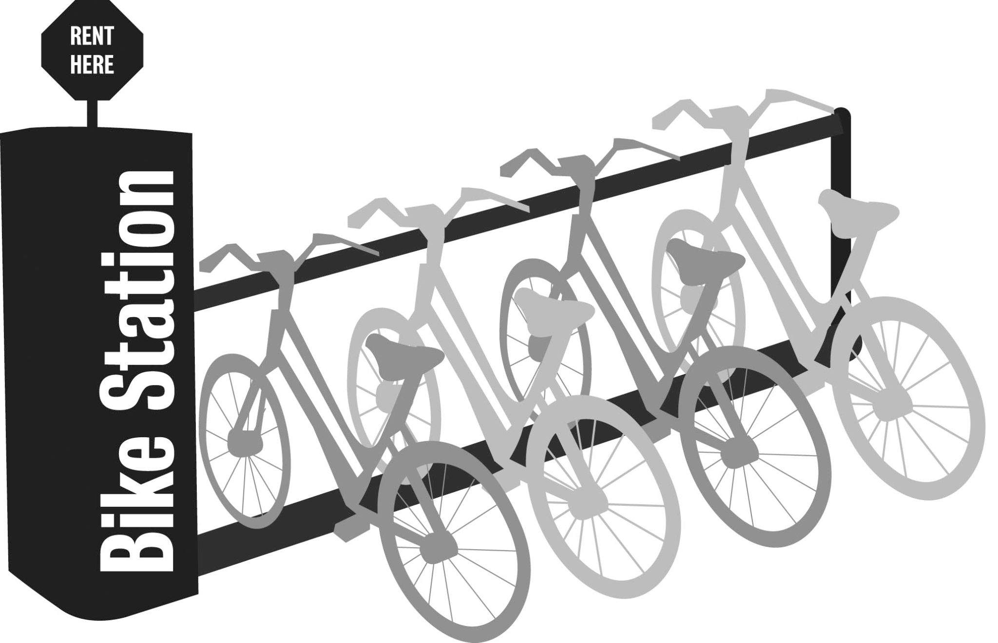
Overview of the Transformed Data
Response Variable:
availability:
YES: station has at least 20% bikes available
NO: station has less than 20% bikes available
Explanatory Variables:
is_weekday: the day is a weekday
month: month of the trip
PRCP: precipitation rate during day of the trip
TAVG: average temperature during day of the trip
hour_minute: during which 30 minutes of the day the bike ride happened
station_id: station number

Slide 7
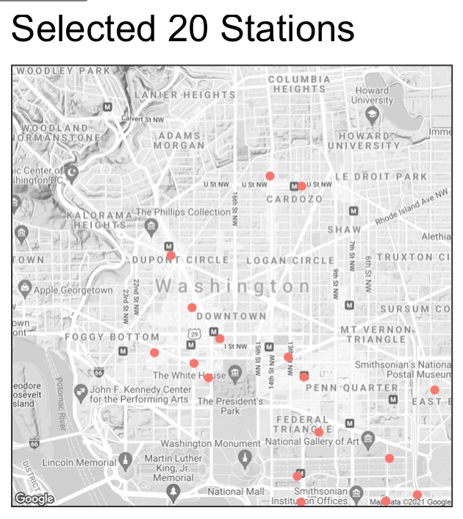
Clustering of Stations
Clustering based on:
Longitude
Latitude
Variance of availability
From the 5 resulting clusters, we focused on the central cluster with supposedly higher demand
From this central cluster, we then chose the top 20 stations with highest variance of bike availability
To ensure the 20 stations portrayed similar characteristics in availability trends
To ensure stations are not too far apart from each other (reshuffling efficiency)
Notes:
We wanted to start with fewer subset of stations to focus on building an accurate model first before building up to other clusters

Slide 8
Final Model and Results - Random Forest
We sampled the data to ensure that it consist of 50% “Yes” and 50% “No” in availability so that the model can learn both cases equally
We split the data into 95% training set and 5% test set
Using the transformed data for the 20 selected stations, we chose to fit a Random Forest model to predict availability (“Yes” or “No”) after comparing this model with Logistics Regression Model
Actual | Predicted
 | Yes | No
Yes | 4,164 | 843
No | 607 | 4,386
Overall Accuracy | 85.5%
Accuracy for “Yes” | 83.2%
Accuracy for “No” | 87.8%
Notes:
Why RF model:
we tried different models (logistic regression) and did not get good results.
lR and RF are all classification models but LR gets much lower accuracy compared to Random Forest
Why sample:
Because of our 20% threshold for the proportion of available bikes, there was a high imbalance in our response variable.
Explain the confusion matrix, meaning :
The records that are classified right
The records that are classified wrong
The accuracy

Slide 9
Model in Practice
To use the model for prediction, the inputs from a user-perspective should be:
is_weekday
month
hour_minute
PRCP:
TAVG:
station_id:
The model can predict the availability status of any stations within our chosen cluster at a user defined time interval for customers
The further the date the user wants to predict, the less accurate the predictions will be because trends can change
Auto-assigned using the date of the user’s request
These can be acquired and auto-updated using weather forecast APIs
This is the station the user is interested in (the only “manual” input needed)
Notes:
The model input should be [time] [weather] [station_id ]
Because the collected data for model fitting and the forecast data for prediction could be quite different. The longer the time, the less accurate the weather forecast could be. Also, you never know what will happen in the future, for example, after COVID-19, in 2020, a lot of companies allowed their employees to work from home and less people would go to offices. This could cause dramatic drop in bike use and the model based on past data would not be that useful

Slide 10

Maintenance of the Model
To maintain the model, we should retrain the model every month to update the model based on recent trends
Maintain a “window” of one year: delete the oldest month, and add recent corresponding month
e.g. [August 2020-August 2021] → [Sep 2020 - Sep 2021] → [Oct 2020 - Oct 2021] …
Most importantly, we need to ensure that all relevant variables are tracked consistently (e.g. 2020 March stops tracking the bike_id per trip)
Notes:
As said before, the model won’t perform well if the predicted time is too far away from now, to solve the problem, we can update the data and refit the model. That’s to say, we can maintain a window of one year and delete oldest month add the recent corresponding month. For example,
One thing that is truly important is we need to make sure the updated data still have all the variables we need. For example, the 2020 March data doesn’t contain bike_id per trip, this will make us unable to calculate the availability bikes proportion and thus unable to have our response variable.

Slide 11
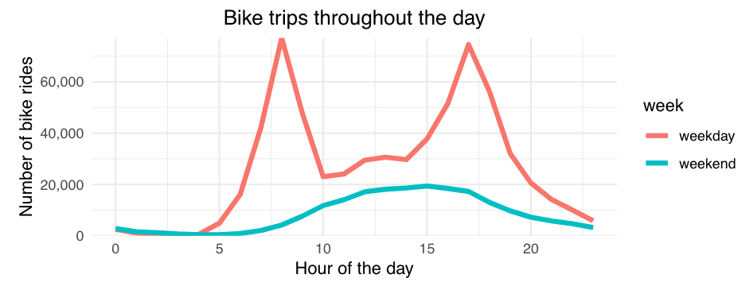
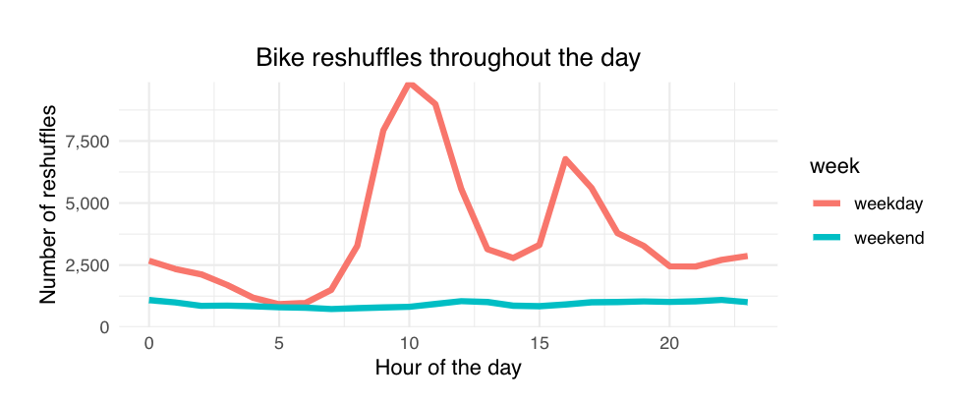
Understanding the Reshuffling Patterns
Our cluster of stations are nearby busy districts and office buildings
Bike rides reach peaks during two rush hours
7AM ~ 9AM (morning)
5PM ~ 7PM (evening)
Bike reshuffles peaks:
After morning rush hours
Before evening rush hours

Slide 12
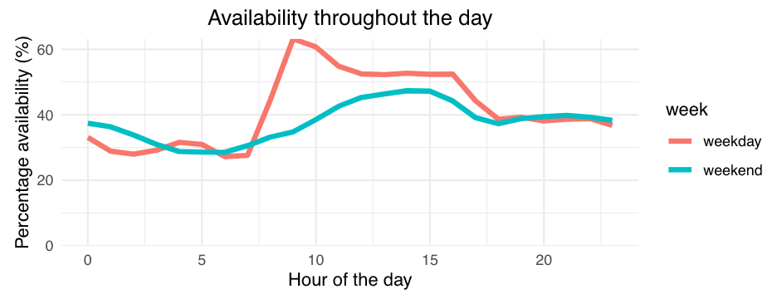
Availability Trends and Reshuffling Strategy
Morning rush:
Huge influx of bikes that shoots up bike availability to 60%
After morning rush, reshuffling is done to prevent stations overloading with bikes
Evening rush:
Large decrease in bike availability to 40%
Before evening rush, bike availability remains high
Reshuffling is done to maintain bikes that people can ride back home

Slide 13
Availability Trends and Reshuffling Strategy
Availability is high between the two rush hours, although not many bike riders
This suggests idle bikes not being utilized efficiently
They should be re-allocated to other clusters / stations in need
Use our model to predict which specific stations or clusters suffer from low availability at the time interval
Notes:
We also wanted to know if the majority of the reshuffles were meant for the trucks to take away the bikes or bring in more bikes
After a bit of digging into the data, we found that the trucks were more likely to take away the bikes as the availability reached higher levels.
The majority of the reshuffling that happen at the peak availability, was the trucks taking away the bikes. Obvious but felt the need to confirm.

Slide 14
Actionable Recommendation
Much like our chosen cluster, different clusters would have differing needs at certain time of the day
Some clusters could be short of bikes at a certain time of the day
Some clusters could have more bikes than needed (underutilized)
We could expand this concept to fit models for different clusters and capture their own characteristics by predicting availability patterns
Adjust our future reshuffling strategies
Notes:
That 0.4 ensures that riders would have enough bikes to ride, and at the same time lower rebalancing needs especially when reaching extremely high or low availability. More station spots allows rebalancing to be performed at significantly longer intervals.
Using our model to predict availability at a station at a particular time, we would be able to identify certain patterns in clusters of stations where there is a shortage of bikes or surplus of bikes at certain time periods (like our cluster).

Slide 15
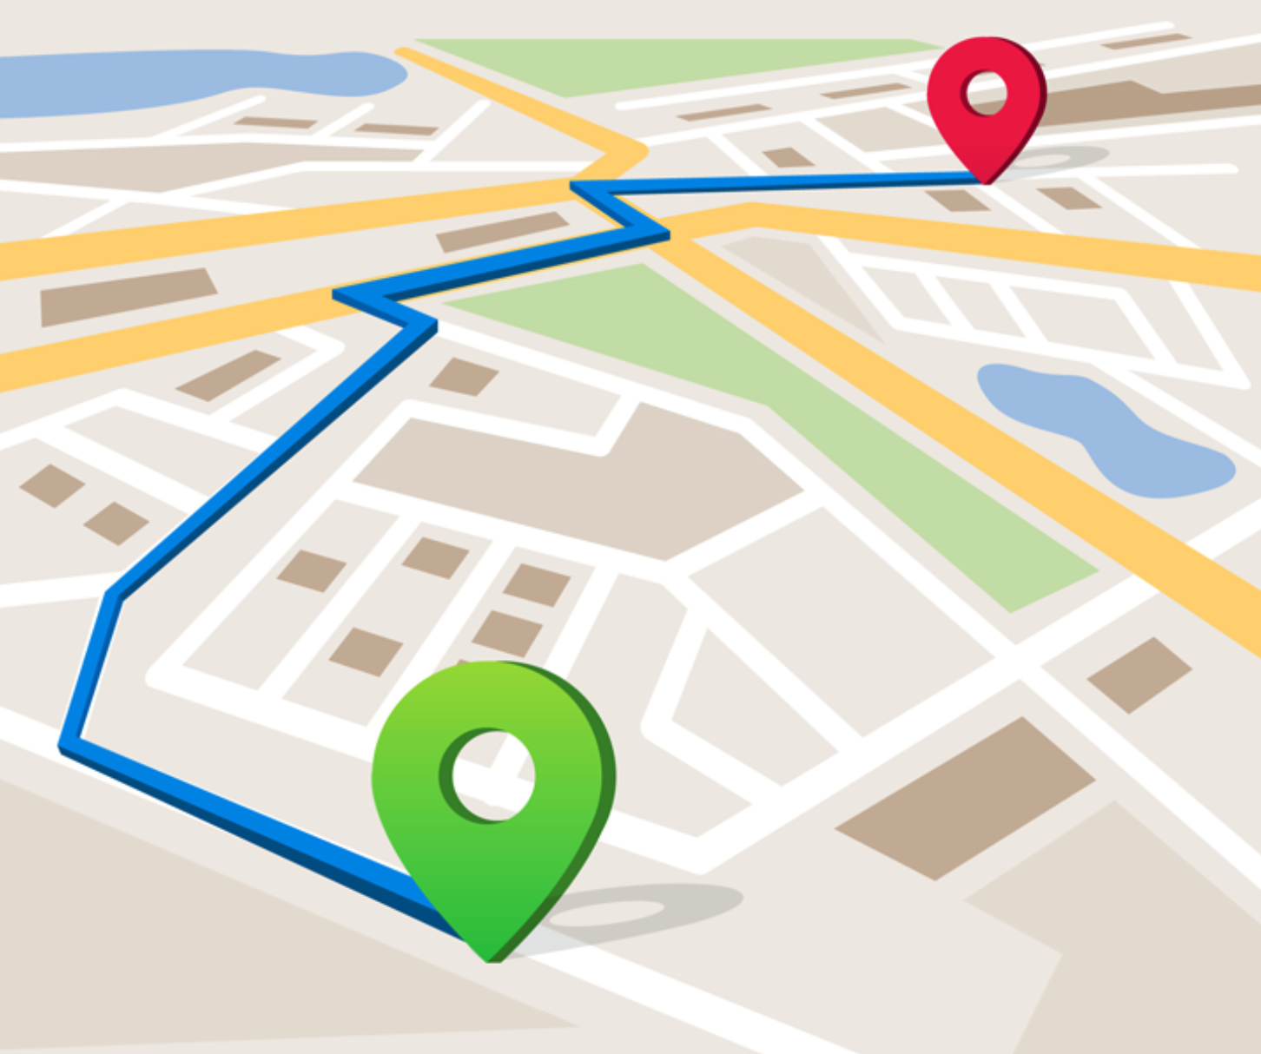
Optimization of Operational Cost
Capture additional data on reshuffling field-workers
Price of gasoline
Wage for the driver
Capacity of bikes a truck can take
Distance between stations
Create “optimal” route for field-workers to reshuffle bikes
Our aim would be to minimize total operation costs while achieving balanced bike availabilities that meet the needs of different station clusters
Reduce unnecessary reshuffles
Increase necessary reshuffles
Notes:
After we understand the characteristics of different clusters / stations, we translate that to an actionable reshuffling strategy

Slide 16



Next Steps for Phase 2
Identify other distinct clusters of stations
Rural areas
Parks
Schools
Expand our model concept to be able to predict for these additional stations and clusters
Create separate models for 2020 / 2021 that can account for COVID pandemic
Adds complexity, but more relevant to today’s time

Slide 17
Thank You!
Q
Any Questions?

Slide 18
Technical Appendix

Slide 19
Transformation of the Raw Dataset
Each observation of trips in the raw data was split into 2 separate trips:
Bike picked up
Bike dropped off
Reshuffling of bikes was not accounted for in the raw dataset, and needed to be treated as separate trips
We assumed that reshuffling occurred when bike last arrived at station A, but was recently picked up from station B
We added starting number of bikes at each station in January 1st 2019, by using data from 2018 December
Total number of bikes that arrived in 2018 December
We defined availability to be the proportion of available bikes at a station in a given time
Availability = Number of bikes at a station in a given time / Total capacity of that station
Notes:
The data needed to be transformed into a structure that could be fed into a predictive classification model
In raw data, each observation had information regarding the start and end of a trip, an optimal way to change this was to divide it into 2 separate trips
Pick up
Drop off
15% was chosen as the threshold because it is a low enough value for a bike to be unavailable by the time a rider reaches a station

Slide 20
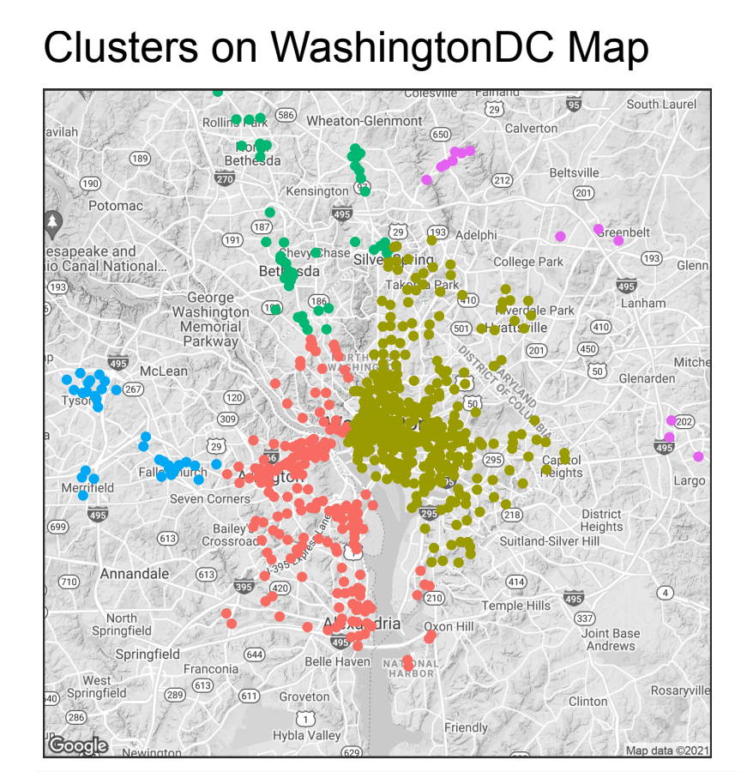
Clustering of Stations
We first performed hierarchical clustering based on:
Longitude
Latitude
We ended up producing 5 different cluster groups
We wanted to focus specifically on the central clusters where we hypothesized there will be higher demands
Urban area
Busier streets & office buildings

Slide 21
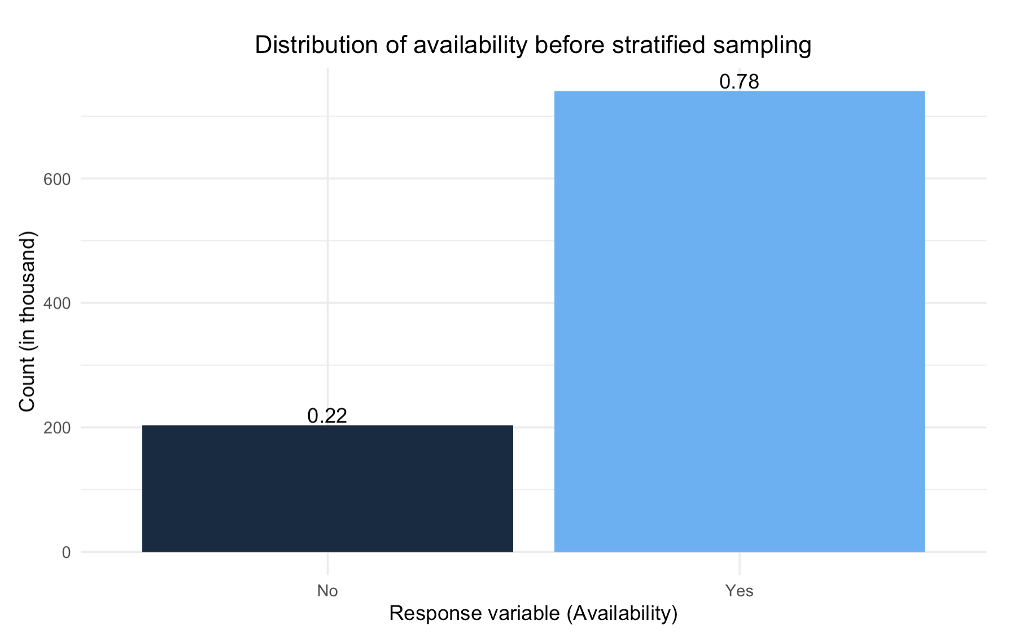
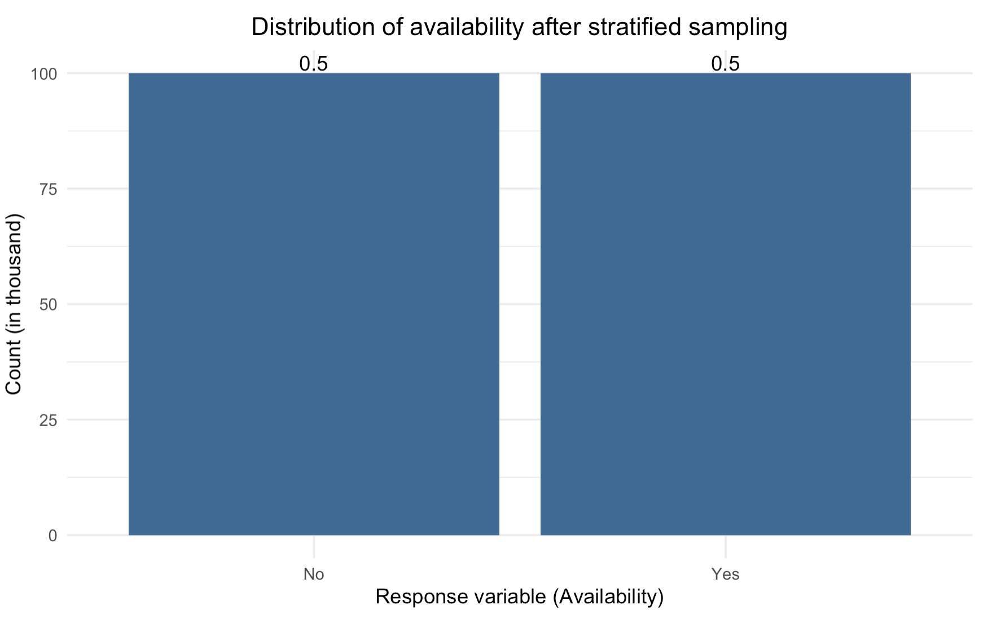
Handling Data Imbalance
Because of our 20% availability threshold, there was a high imbalance in our response variable
~80% “Yes”, ~20% “No”
The model failed to learn about the “No” cases
We used stratified sampling to ensure that our training sample data had 50:50 ratio between y = “Yes” and y = “No” observations
Then, with the correctly trained model, we created a test set sampled from the true population to validate our model accuracies
This significantly improved our model’s performance on the negative y=”No” cases

Slide 22


Summary of Methodology
Random Forest
Logistics Regression
Random Forest is a common learning method for classification using decision trees.
Logistic Regression uses a logistic function to model the dependent variable. The dependent variable is dichotomous in nature, i.e. there could only be two possible classes

Slide 23
Model Results
Random Forest
Confusion Matrix of the Actual and the Predicted
Logistics Regression
Confusion Matrix of the Actual and the Predicted
Actual | Predicted
 | Yes | No
Yes | 4,164 | 843
No | 607 | 4,386
Actual | Predicted
 | Yes | No
Yes | 3,436 | 1,571
No | 1,925 | 3,068
Overall Accuracy: 85.5%
Accuracy for “Yes”: 83.2%
Accuracy for “No”: 87.8%
Overall Accuracy: 58.2%
Accuracy for “Yes”: 54.8%
Accuracy for “No”: 61.7%

Slide 24
Availability Trends and Reshuffling Strategy
We fit a Logistic regression model:
10% increase in availability(%) leads to 4% increase in odds of reshuffle
Reshuffle type | Average availability
Bring in bikes (+1) | 37.8%
Take out bikes (-1) | 48.5%
We found that the trucks were more likely to take away the bikes as the availability reached higher levels.
The majority of the reshuffling that happen at the peak availability, was the trucks taking away the bikes.

